Slide 1
World’s Largest Data Warehouse
Navneet Goyal
Department of Computer Science
BITS, Pilani (Pilani Campus)

Slide 2
World’s Largest Data Warehouse
SAP in conjunction with NetApp and several other partners
@ SAP/Intel data center in Santa Clara, California
12 petabytes (PB) of addressable storage had been created
Guinness World Record
Based on the SAP® HANA in-memory data platform, SAP IQ (formerly Sybase IQ), and BMMsoft Federated EDMT.
NetApp® SAN storage
Contains more than 221 trillion transactional records
more than 100 billion unstructured documents, including emails, SMS, and images
It also contains data from 30 billion sources, including users, smart sensors, and mobile devices.
Source:
An Insider’s View into the World’s Largest Data Warehouse
by Larry Freeman, NetApp

Slide 3
World’s Largest Data Warehouse
To achieve these impressive results, a data warehouse environment was created by ingesting 3 PB per day of synthetic data for four consecutive days—a feat that required exceptional storage system performance and reliability. For that, SAP turned to NetApp® SAN storage

Slide 4

SAP HANA: In-Memory Database
Companies are always trying to find the best way to store data in a meaningful format so that they can make better business decisions
Since the birth of data warehousing almost 30 years ago, numerous innovations in data management have been made, such as Hadoop and NoSQL
HANA (High-Performance Analytic Appliance)
A platform for processing high volumes of operational and transactional data in real time
All material related to HANA taken from:

Slide 5
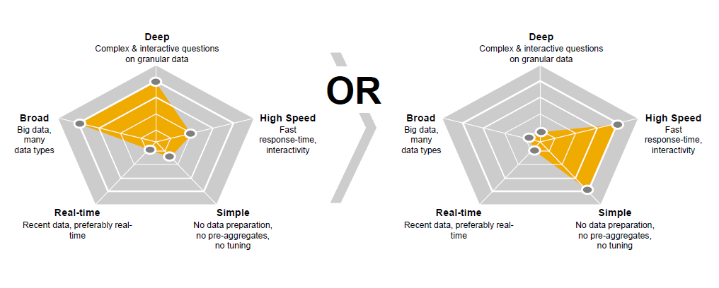
SAP HANA: In-Memory Database
Today’s Technology requires tradeoff

Slide 6
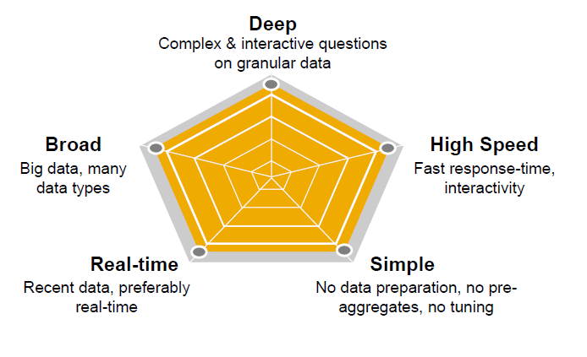
SAP HANA: In-Memory Database
Delivering across 5 dimensions of decision processing

Slide 7
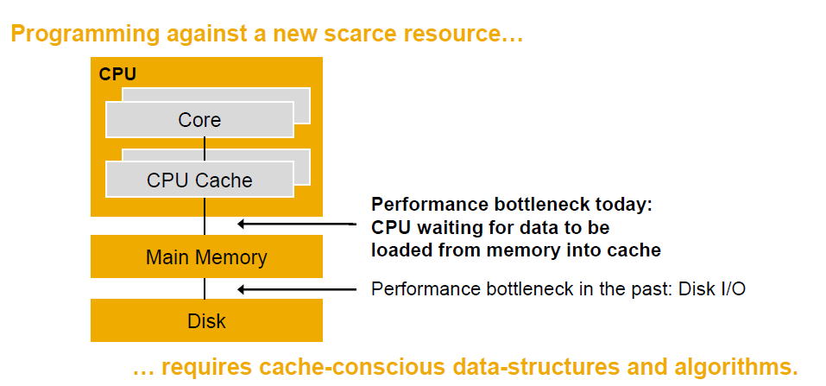
SAP HANA: In-Memory Database
In-memory computing

Slide 8
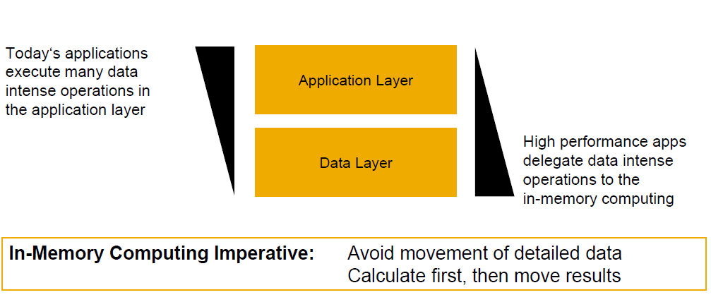
SAP HANA: In-Memory Database
In-memory computing

Slide 9
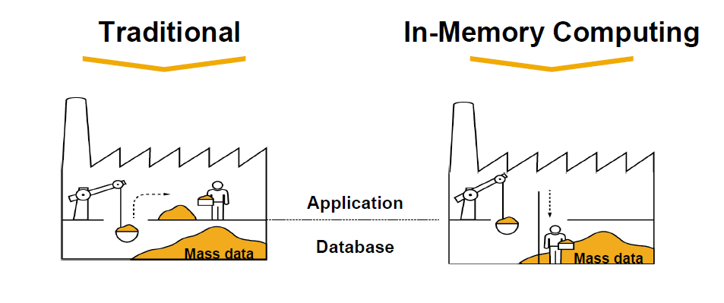
SAP HANA: In-Memory Database
In-memory computing

Slide 10
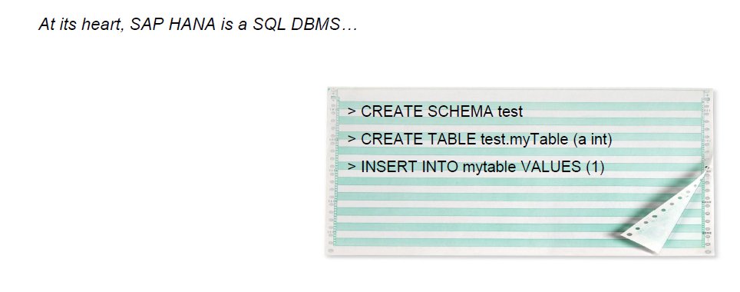
SAP HANA: In-Memory Database
Storing Data

Slide 11
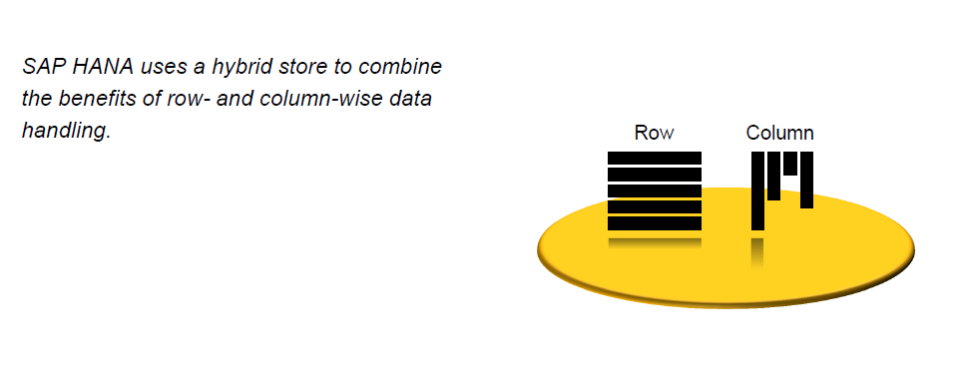
SAP HANA: In-Memory Database
Storing Data

Slide 12
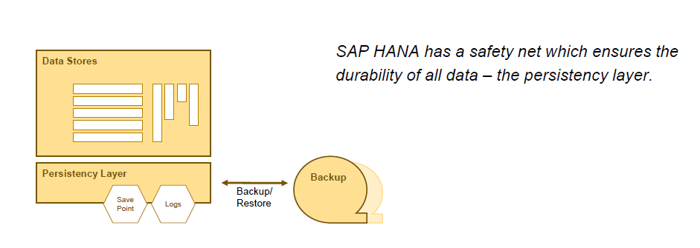
SAP HANA: In-Memory Database
Storing Data

Slide 13
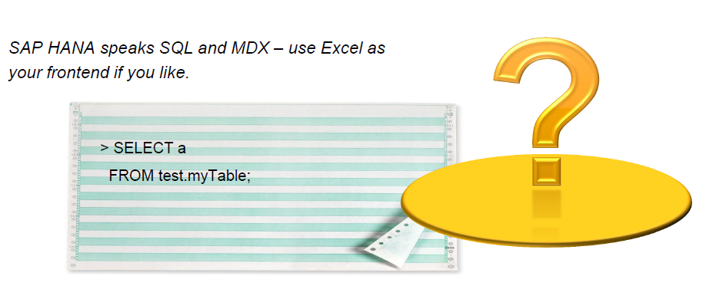
SAP HANA: In-Memory Database
Using Data

Slide 14
NetApp SAN Storage
deployment of the storage hardware (weighing nearly two tons!) occurred over several
NetApp E-Series storage was deployed for the majority of the data, to the tune of a total of 5.4 petabytes of physical storage capacity spread across 20 E5460 storage arrays and 1,800 three terabyte NL-SAS disk drives
The record of 12.1 petabytes of total addressable capacity was achieved thanks in large part to an SAP in-system data compression rate of 85% for the 50/50 mix of structured and unstructured data.
NetApp E-Series storage was selected for the project because of its proven 99.999% availability and its ability to handle the project’s data ingest requirement of 34.3 TB per hour
The E-Series SAN used a Fibre Channel fabric to support SAP IQ’s large and varied data needs
Source:
An Insider’s View into the World’s Largest Data Warehouse
by Larry Freeman, NetApp

Slide 15
SAP IQ
A highly optimized RDBMS built for extreme-scale Big Data analytics and warehousing
Developed by SYBASE. Now a SAP company
SAP IQ holds the Guinness World Record for fastest loading and indexing of Big Data
IQ is a column-based, petabyte scale, relational database software system used for business intelligence, data warehousing, and data marts
Its primary function is to analyze large amounts of data in a low-cost, highly available environment
SAP IQ is often credited with pioneering the commercialization of column-store technology

Slide 16
A word about HIVE
A data warehouse infrastructure built on top of Hadoop
Enables easy data summarization, adhoc querying and analysis of large datasets data stored in Hadoop files.
provides a mechanism to put structure on this data
A simple query language called Hive QL (based on SQL) which enables users familiar with SQL to query this data.
HIVE QL allows traditional map/reduce programmers to be able to plug in their custom mappers and reducers to do more sophisticated analysis which may not be supported by the built-in capabilities of the language.

Slide 17
A word about HIVE
HIVE provides:
Tools to enable easy data extract/transform/load (ETL)
A mechanism to impose structure on a variety of data formats
Access to files stored either directly in Apache HDFS or in other data storage systems such as Apache HBase
Query execution via MapReduce

Slide 18
Thank You

